Slide 1

Use Particle Swarm Optimization via MATLAB: Employ the Function
Professor Bo Liu
James Watt School of Engineering

Slide 2
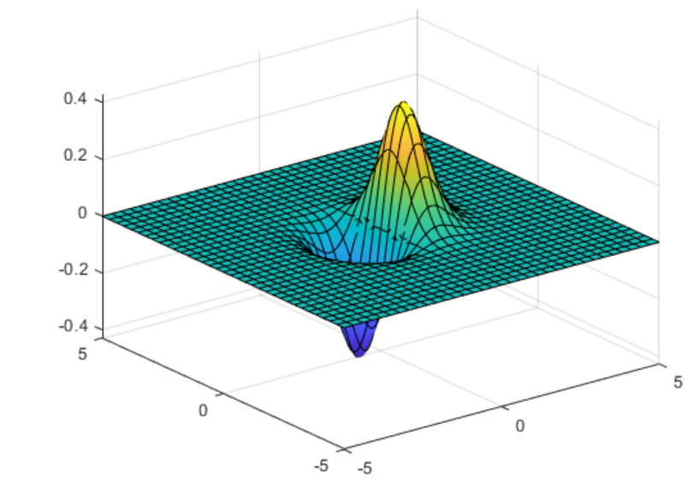


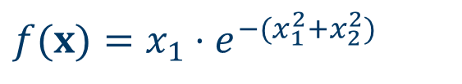
Benchmark function
Example: An exponential function of two variables
$$f(x)=x_{1}⋅e^{−(x_{1}^{2}+x_{2}^{2})}$$
Global Minimum: f(x*) = -0.4289,
x* = [-0.7071, 0]
$$x_{2}$$
$$x_{1}$$

Slide 3
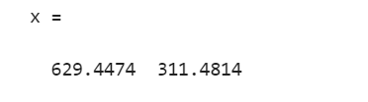
Use PSO to solve benchmark problems
rng default % For reproducibility
fun = @(x)x(1)*exp(-norm(x)^2);
nvars = 2;
x = particleswarm(fun, nvars)
This solution is far from the true minimum.
See live script for similar examples

Slide 4

Use PSO to solve benchmark problems
fun = @(x)x(1)*exp(-norm(x)^2);
lb = [-10,-15];
ub = [15,20];
rng default % For reproducibility
nvars = 2;
x = particleswarm(fun, nvars, lb, ub)
This solution is very near to the true minimum. The search range is impactful considering the result.
See live script for similar examples

Slide 5
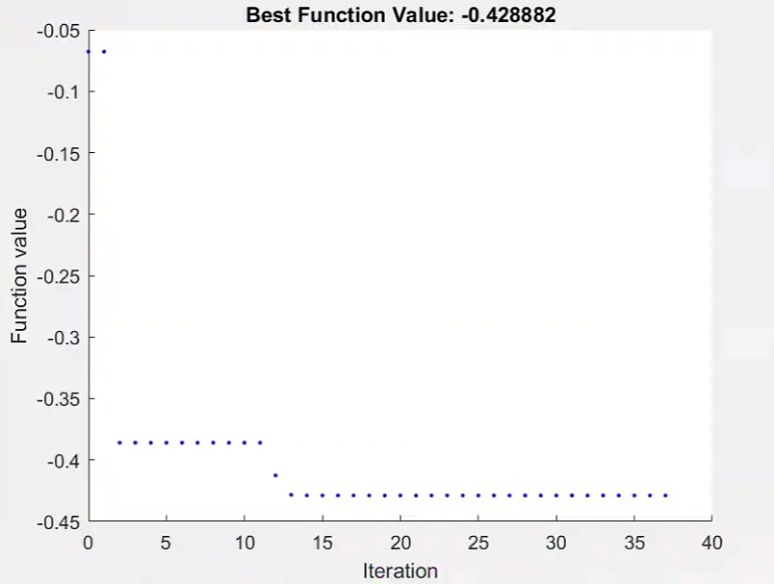
Use PSO to solve benchmark problems
fun = @(x)x(1)*exp(-norm(x)^2);
lb = [-10,-15];
ub = [15,20];
Options =optimoptions('particleswarm','PlotFcn',@pswplotbestf,'SwarmSize’,100);
rng default % For reproducibility
nvars = 2;
x = particleswarm(fun, nvars, lb, ub)
This solution is very near to the true minimum.
See live script for similar examples

Slide 6
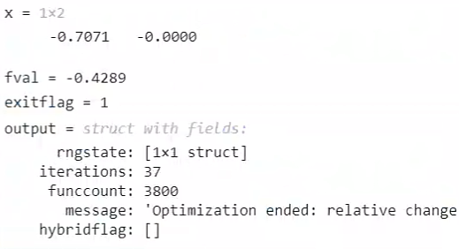
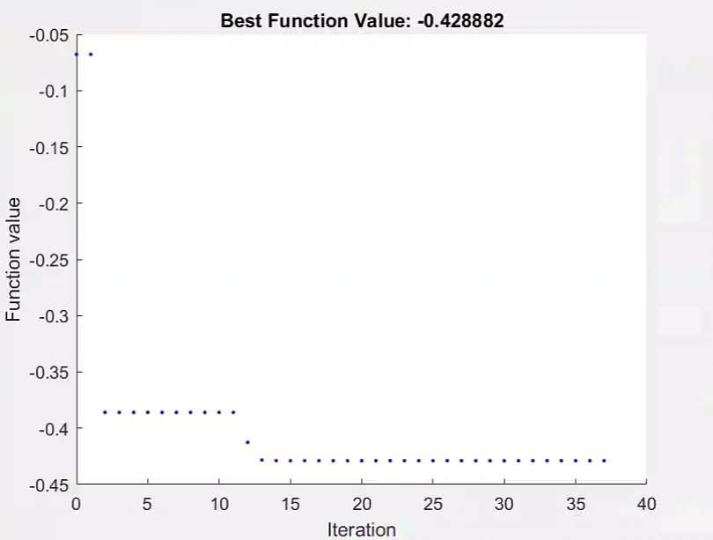
Use PSO to solve benchmark problems
fun = @(x)x(1)*exp(-norm(x)^2);
lb = [-10,-15];
ub = [15,20];
options =optimoptions('particleswarm','PlotFcn’,@pswplotbestf,'SwarmSize’,100);
rng default % For reproducibility
nvars = 2;
[x, fval, exitflag, output] = particleswarm(fun, nvars, lb, ub, options)
This solution is very near to the true minimum.
See live script for similar examples

Slide 7




Thanks!
#UofGWorldChangers
@UofGlasgow

